Slide 1


Mol-Optimizer Semester B Marathon Presentation
Amit Peled, Daniel Piro, Shahar Alon & Nofar Rozenberg

Slide 2
Marathon Goals
Finish UI design.
Finish User Management & Runs Management.
Full API integration between Frontend & Backend.
Algorithms running in the system.
Algorithms Optimizations.
Start Testing MolOpt.

Slide 3
UI Design
All pages in the pages in the app are set and ready to use.
All UI-Logic has been done (Which sections, components, buttons, etc. are visible to the user).

Slide 4
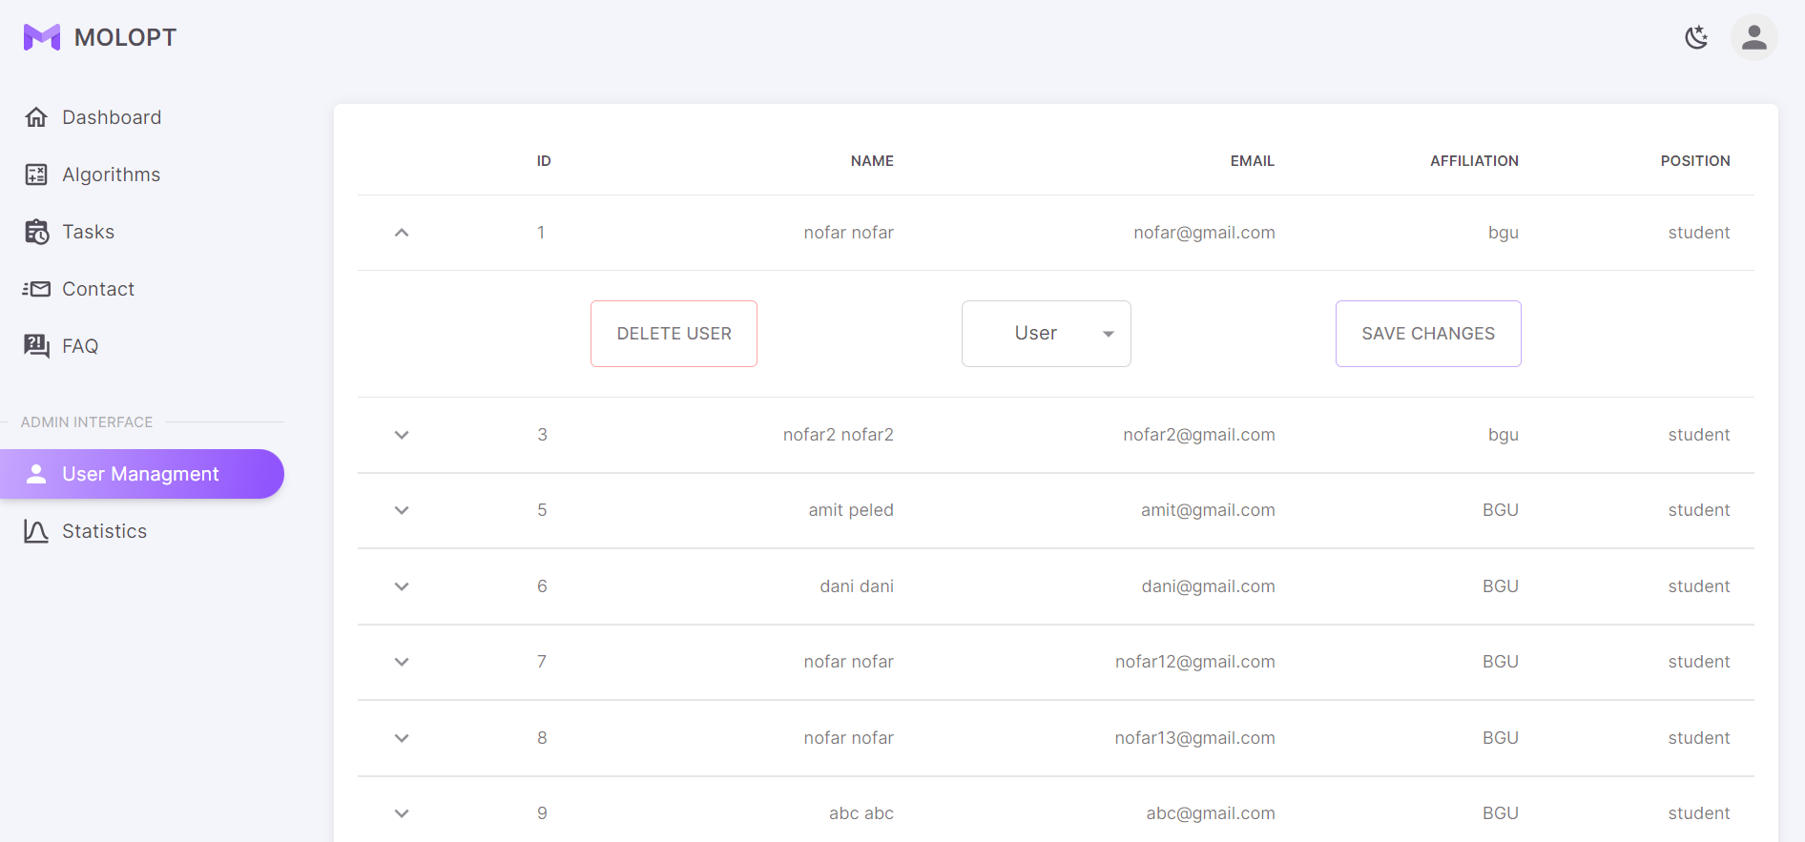
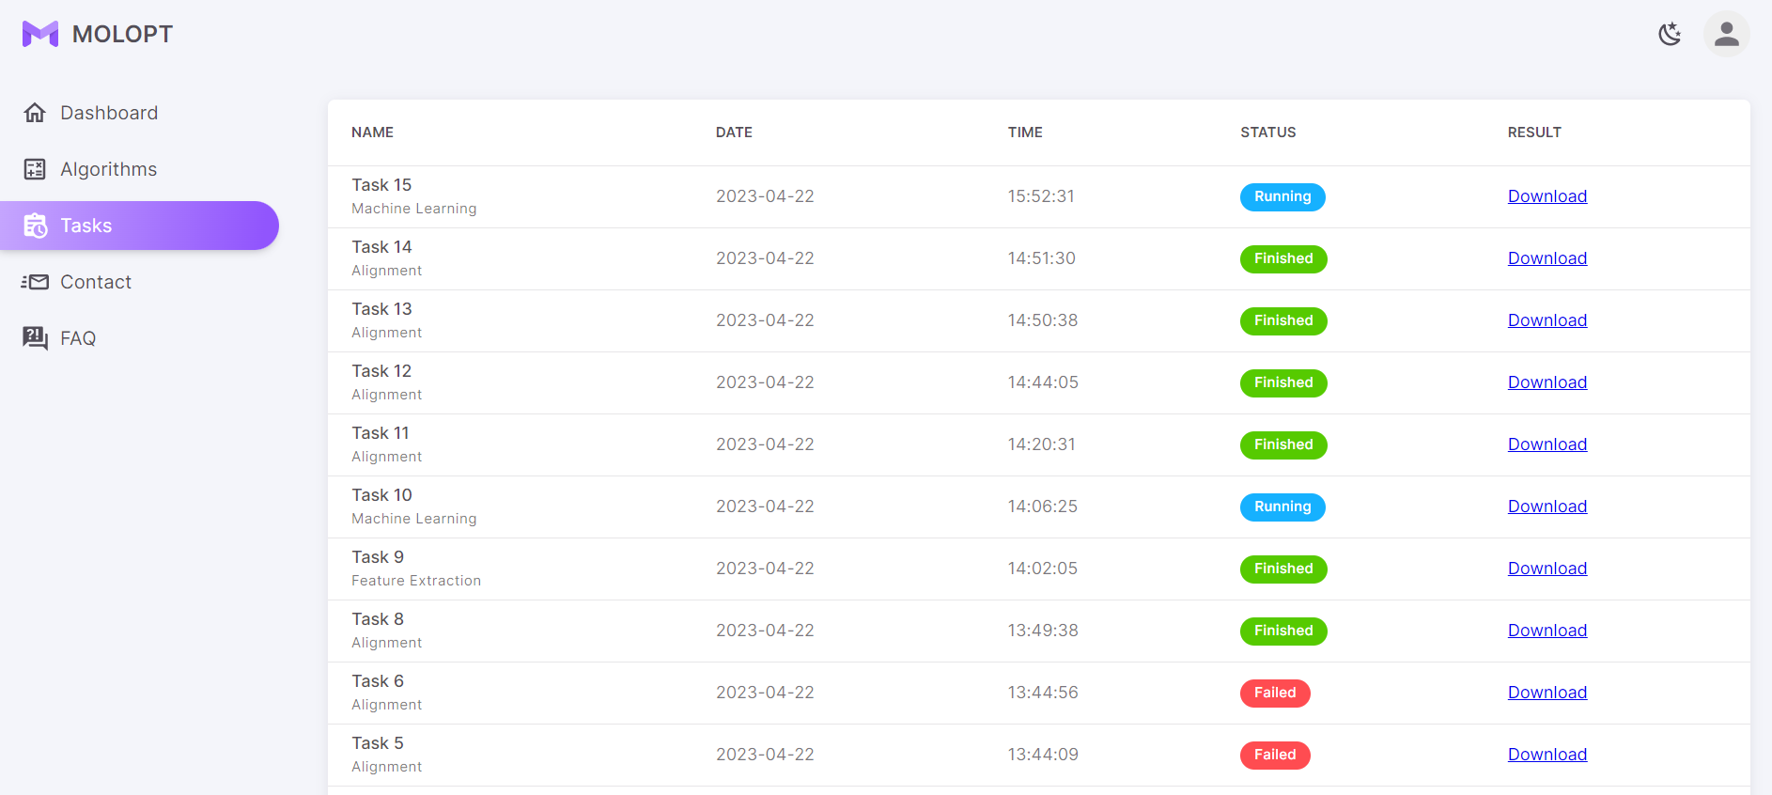
User Management & Runs Management
Photo of the users list (for admin only)
Photo of the tasks list (admin/regular user)

Slide 5
API integration between Frontend & Backend + Algorithms running in the system
(Showing a simple example from back to front)
(Explain about a complex example – such as running an algorithm, from back to front)

Slide 6
Algorithms Optimizations
Adding threading mechanism for running algorithms.
Designing algorithm runs queue.
Updating the current algorithms code (for better running time).

Slide 7
Future Tasks In MolOpt
Continue optimizing the algorithms.
Testing the full system (The only task we had left from the marathon).
Deploying to the BGU servers (still waiting for a server from our client).

Slide 8
Thank You! ☺

